Slide 1

Store Sales Analysis
Brian Tobin
Project Source - Medium

Slide 2
About Project
This is a recreation of the "Data Analyst Portfolio Project in Excel#1: Sales Improvement Of A Store." on the Medium website. The article ca be found here:
Data Analyst Portfolio Project in Excel#1: Sales Improvement Of A Store.
(https://medium.com/@ritikasood/data-analyst-portfolio-project-in-excel-1-sales-improvement-of-a-store-4b9e2c41012a)

Slide 3
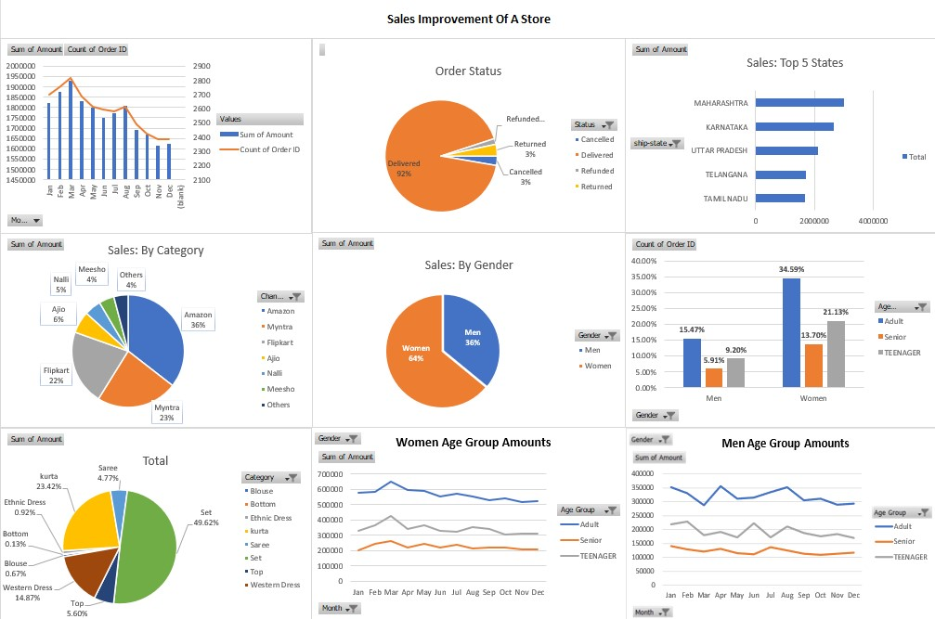
Dashboard

Slide 4
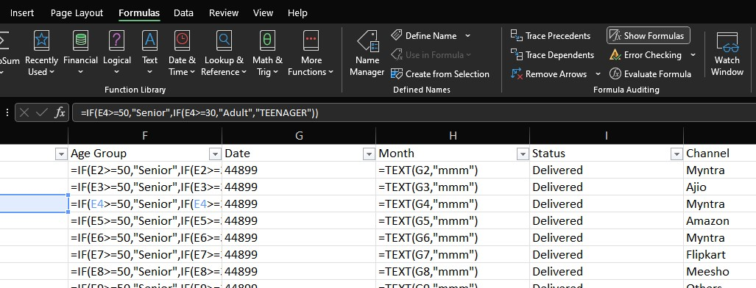
Formulas

